Slide 1
BANK ACCOUNT MANAGEMENT
SYSTEM
Capstone Project – Review II
Database Implementation
Database Management Systems (2501IT05)
Faculty – Dr.P.Kishore Kumar
PRESENTED BY
JASWANTH KARTHIKEYA (25B11AIC83)
A.PRASANNA KUMAR (25B11AI072)
K.MURALI KRISHNA (25B11AI518)
K.PRASANNA KUMAR (25B11AI488)

Slide 2
1. Project Overview
Bank Account Management System is a database system for managing bank-related information.
It stores customer, account, branch, employee, transaction, and loan details.
It maintains relationships between different tables using Primary Keys and Foreign Keys.
SQL is used to insert, update, delete, retrieve, and analyze data.
Constraints are used to maintain data accuracy and integrity.
The system reduces data duplication through normalization.
Main Modules :
Customer Management
Account Management
Branch Management
Employee Management
Transaction Management
Loan Management
2

Slide 3
2. Existing System and Proposed System
Existing System | Proposed System
Records may be maintained manually. | Data is stored in a centralized database.
More chances of duplicate data. | Normalization reduces data duplication.
Difficult to search and update records. | SQL makes searching and updating easier.
Data relationships are not clearly maintained. | Primary and Foreign Keys maintain relationships.
Data accuracy can be difficult to maintain. | Constraints improve data integrity.
Reports and analysis take more time. | SQL queries provide quick information and analysis.
Manual and scattered data → Organized, connected, and reliable database system
3

Slide 4
3. Functional Requirements
The system should provide the following functions:
Customer Management | Add, view, update, and manage customer details.
Account Management | Store account number, type, balance, opening date, and status.
Branch Management | Maintain branch details such as name, IFSC code, address, and city.
Employee Management | Store employee details and their assigned branch.
Transaction Management | Record deposits and withdrawals with amount, date, and status.
Loan Management | Maintain loan type, loan amount, interest rate, and customer details.
Data Retrieval & Analysis | Use SQL queries, joins, aggregate functions, GROUP BY, and HAVING to retrieve useful information.
Key Requirement :
The database must maintain accurate, consistent, and secure relationships between all tables.
4

Slide 5
4. Database Schema Used for Implementation
Table | Primary Key | Foreign Keys
1. CUSTOMER | Customer_ID (PK) | —
2. ACCOUNT | Account_Number (PK) | Customer_ID (FK), Branch_ID (FK)
3. BRANCH | Branch_ID (PK) | —
4. EMPLOYEE | Employee_ID (PK) | Branch_ID (FK)
5. TRANSACTION | Transaction_ID (PK) | Account_Number (FK)
6. LOAN | Loan_ID (PK) | Customer_ID (FK)
Relationships :
Customer → Account (1:M)
Branch → Account (1:M)
Branch → Employee (1:M)
Account → Transaction (1:M)
Customer → Loan (1:M)
5

Slide 6
5. Table Design and Constraints
Table | Key / Validation Rules
Customer | PK Customer_ID; NOT NULL Name, Phone; UNIQUE Email
Account | PK Account_Number; NOT NULL Account_Type, Balance; FKs Customer_ID, Branch_ID; CHECK Balance >= 0
Branch | PK Branch_ID; NOT NULL Branch_Name; UNIQUE IFSC_Code
Employee | PK Employee_ID; NOT NULL Employee_Name; FK Branch_ID
Bank_Transaction | PK Transaction_ID; NOT NULL Transaction_Type, Amount; FK Account_Number; CHECK Amount > 0
Loan | PK Loan_ID; NOT NULL Loan_Type, Loan_Amount; FK Customer_ID; CHECK Loan_Amount > 0
Primary Keys identify records, Foreign Keys connect tables, and Constraints maintain valid and consistent data.
6

Slide 7
6. Normalization up to 3NF
Purpose:
Normalization organizes the database to reduce duplicate data and avoid data inconsistency.
Normal Form | Implementation in Our Database
1NF | Each table has atomic values and no repeating groups.
2NF | All non-key attributes depend on the complete primary key.
3NF | No unnecessary dependency between non-key attributes.
Result | Data duplication is reduced and tables are easier to maintain.
Example
Instead of storing customer details repeatedly in the Account table:
Customer → stores customer details
Account → stores account details + Customer_ID as FK
7

Slide 8
7. SQL Implementation – DDL
DDL – Data Definition Language
DDL is used to create and modify the structure of the database.
Commands used in our project:
Example :
CREATE DATABASE – Creates the bank database.
CREATE TABLE – Creates all required tables.
ALTER TABLE – Adds or modifies columns.
TRUNCATE – Removes all records while keeping the table structure.
DROP TABLE – Removes a table completely.
CREATE TABLE Customer (
Customer_ID INT PRIMARY KEY,
Name VARCHAR(100) NOT NULL,
Date_of_Birth DATE NOT NULL,
Gender VARCHAR(10),
Phone VARCHAR(15) NOT NULL,
Email VARCHAR(100) UNIQUE,
Address VARCHAR(200)
);
DDL defines the structure of our Bank Account Management System database.
8

Slide 9
8. SQL Implementation – DML
DML – Data Manipulation Language
DML is used to add, modify, and remove data stored in the tables.
Commands used in our project:
Example :
INSERT – Adds new records.
UPDATE – Modifies existing records.
DELETE – Removes records.
→ INSERT
INSERT INTO Customer
VALUES (106, 'Ravi Kumar', '2002-06-10',
'Male', '9876543215',
'ravi@gmail.com', 'Hyderabad');
→ UPDATE
UPDATE Customer
SET Phone = '9876543220'
WHERE Customer_ID = 106;
→ DELETE
DELETE FROM Customer
WHERE Customer_ID = 106;
DML manages the actual data stored inside our database tables.
9

Slide 10
9. DQL – Data Retrieval
DQL – Data Query Language
DQL is used to retrieve and view data from the database.
Queries implemented:
→ SELECT
SELECT * FROM Customer;
→ WHERE
SELECT * FROM Account
WHERE Balance > 30000;
→ ORDER BY
SELECT * FROM Account
ORDER BY Balance DESC;
→ DISTINCT
SELECT DISTINCT Account_Type
FROM Account;
→ LIKE
SELECT * FROM Customer
WHERE Name LIKE 'A%’;
→ BETWEEN
SELECT * FROM Account
WHERE Balance BETWEEN 20000 AND 60000;
DQL helps us search, filter, sort, and retrieve required information from the database.
10

Slide 11
10. SQL Queries – Joins
Joins are used to combine data from two or more related tables using common fields.
Joins implemented in our project :
1. INNER JOIN :
2. JOIN with Branch :
Displays matching records from related tables.
SELECT Customer.Name, Account.Account_Number,
Account.Balance
FROM Customer
INNER JOIN Account
ON Customer.Customer_ID = Account.Customer_ID;
SELECT Account.Account_Number, Branch.Branch_Name, Branch.City FROM Account INNER JOIN Branch ON Account.Branch_ID = Branch.Branch_ID;
Joins help us view related information from multiple tables in a single result.
11

Slide 12
11. SQL Queries – Aggregate Functions
Aggregate Functions :
Aggregate functions are used to perform calculations on multiple records and return a single result.
Functions used:
Example :
COUNT() – Counts the number of records.
SUM() – Calculates the total value.
AVG() – Calculates the average value.
MAX() – Finds the highest value.
MIN() – Finds the lowest value.
SELECT COUNT(*) AS Total_Accounts FROM Account;
SELECT SUM(Balance) AS Total_Balance FROM Account;
SELECT AVG(Balance) AS Average_Balance FROM Account;
SELECT MAX(Balance) AS Highest_Balance FROM Account;
SELECT MIN(Balance) AS Lowest_Balance FROM Account;
Aggregate functions help us analyze account data and generate useful numerical information.
12

Slide 13
12. CRUD Operations
CRUD Operations
CRUD represents the four basic operations performed on database data
C – Create
R – Read
INSERT INTO Customer
VALUES (106, 'Ravi Kumar', '2002-06-10',
'Male', '9876543215',
'ravi@gmail.com', 'Hyderabad');
SELECT * FROM Customer;
D – Delete
DELETE FROM Customer
WHERE Customer_ID = 106;
U – Update
UPDATE Customer
SET Phone = '9876543220'
WHERE Customer_ID = 106;
CRUD operations allow us to add, view, modify, and remove records from the database.
13

Slide 14
13. Views
Database Views
A View is a virtual table created from one or more tables.
It helps us display related information without storing duplicate data.
View implemented in our project :
CREATE VIEW Customer_Account_View AS
SELECT
Customer.Name,
Account.Account_Number,
Account.Account_Type,
Account.Balance,
Branch.Branch_Name,
Branch.City
FROM Customer
INNER JOIN Account
ON Customer.Customer_ID = Account.Customer_ID
INNER JOIN Branch
ON Account.Branch_ID = Branch.Branch_ID;
To display the View :
SELECT * FROM Customer_Account_View;
Customer + Account + Branch → Customer_Account_View
Our view combines Customer, Account, and Branch information into one easy-to-use result.
14

Slide 15

14. Data Integrity and Validation
Validation | How it is maintained
Entity integrity | Primary keys prevent duplicate / NULL identifiers.
Referential integrity | Foreign keys prevent invalid references.
Uniqueness | UNIQUE constraints prevent duplicate Email and IFSC Code values.
Mandatory fields | NOT NULL constraints ensure required fields are provided.
Domain validation | CHECK constraints allow only valid values, such as Balance ≥ 0 and Amount > 0.
Business validation | Account status, transaction type, and the other values are restricted according to project rules.
15

Slide 16
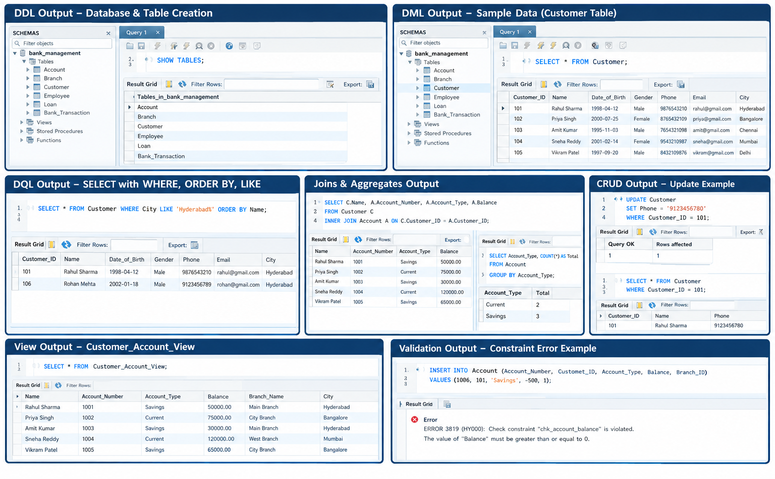
15. SQL Output and Screenshots
16

Slide 17
16. Query Coverage for Demonstration
Category | Demonstration
Basic SELECT | 3–5 queries
Filtering / Sorting | 3–5 queries
Joins | 5+ meaningful joins / multi-table queries
Aggregation | 5+ COUNT, AVG, MIN, MAX, SUM queries
GROUP BY / HAVING | 2–3 queries
CRUD | At least one example for each operation
Views | 1–2 meaningful views
Validation | At least 2 constraint demonstrations
Our database demonstrates SQL operations from basic retrieval to advanced queries, CRUD, views, and data validation.
17

Slide 18
17. Conclusion
Successfully designed and implemented the Bank Account Management System using MySQL.
Six related tables manage Customer, Account, Branch, Employee, Bank_Transaction, and Loan data.
Primary Keys and Foreign Keys maintain relationships between tables.
Normalization up to 3NF reduces data redundancy and keeps the database organized.
Implemented DDL, DML, DQL, CRUD, Joins, Aggregate Functions, GROUP BY, HAVING, and Views.
Constraints and validation help maintain accurate and consistent data.
The system provides a structured foundation for efficient banking data management and reporting.
“Our project provides an organized, connected, and reliable database for managing important banking information.”
18

Slide 19
18. Future Enhancements
Online Banking Integration – Connect the database with a web-based banking application.
Mobile Application – Provide access to account and transaction information through a mobile app.
Fund Transfer Module – Add secure money transfer between accounts.
Loan Management – Add loan approval, repayment, and tracking features.
Reports & Analytics – Generate detailed customer, account, transaction, and loan reports.
User Authentication – Add secure login and role-based access for customers and bank employees.
Backup & Recovery – Implement regular database backup and recovery mechanisms.
Audit Logging – Track important changes made to banking records.
“Future enhancements can extend the database into a complete and secure banking management application.”
19

Slide 20
19. Live Database Demonstration – Recommended Order
1. Open the database / schema.
2. Show the six tables and relationships.
3. Show table structures and constraints.
4. Display inserted sample data.
5. Demonstrate DDL, DML, and DQL.
6. Demonstrate CRUD operations.
7. Run joins and aggregate queries.
8. Demonstrate a view.
9. Demonstrate validation / integrity.
10. Explain normalization up to 3NF and answer questions.
20

